Slide 1


Nashville Rock-and-Roll Marathon Analysis
Group: The Data Question
Date: 09/16/2023
Data Set Time Frame:2016-2019
Notes:
Hello everyone, we are the Data Questions and here are some findings that we want to share from the assignment.

Slide 2
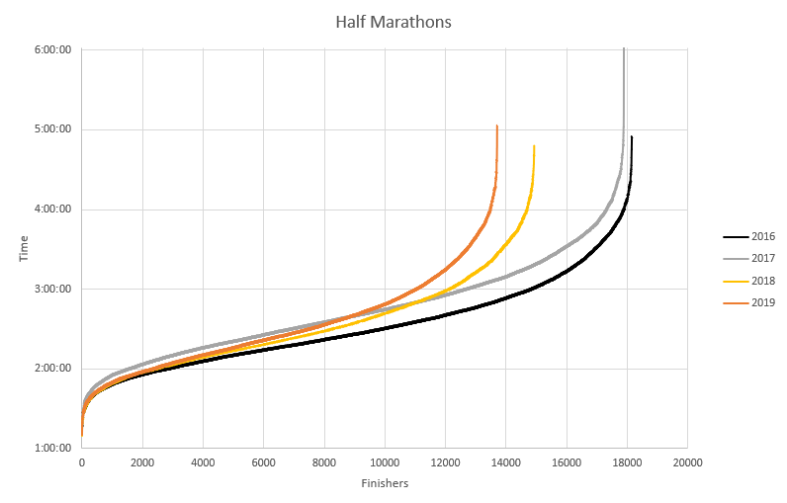
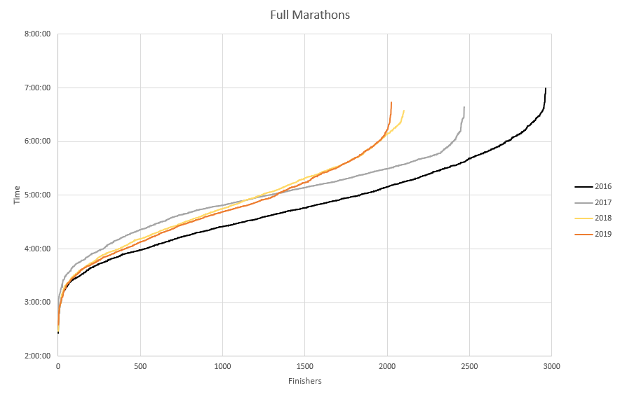
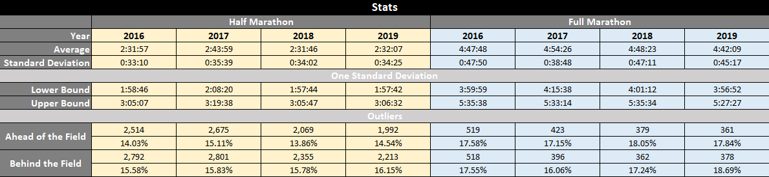
What We Know…
Notes:
The two charts here map out each runner’s time relative to their finishing order, over each year. While each year’s field follows a similar distribution, you can see attendance has decreased year over year for the time period we looked at. Speaking of distributions, each year seems have a similar standard deviation, meaning the majority of times for each half marathon fall within roughly half an hour of the average, and the full marathon times are within roughly 45 minutes of the average. Looking at the folks that came in ahead of and behind that chunk of time, the decreasing numbers of runners make sense given the decrease in attendance, but what’s interesting is the proportions. For the half marathons, with the exception of 2018, the times seem to be skewed slightly lower, with more runners falling behind the standard deviation than ahead of it. For the full marathons, things seem to be skewed in the other direction, with the exception of 2019. This also makes sense, given who we’d expect to see completing a full marathon vs a half marathon. More on that on the next slide.

Slide 3


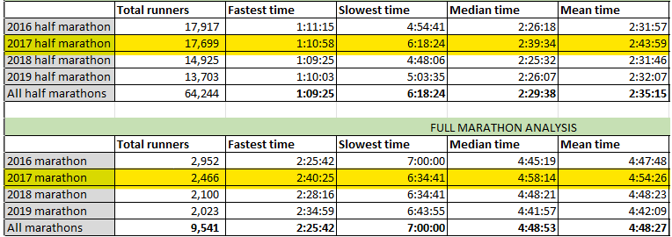
What We Know…
Marathon = 26.2 miles
Half Marathon = 13.1 miles
Marathon Runners = Professionals
Half Marathon Runners = Experimenters
Notes:
As previously shown in our scatter plot, there are some outliers and consistencies. Marathons are 26.2 miles whereas half-marathons are 13.1 miles. Marathon runners can be assumed to be running professionals as half marathon runners are more assumed to be experimenters or hobbyists. As a full marathon runner, it is assumed that you have a high priority on keeping pace and interest in your finishing time. Whereas, a half marathon runner is just happy to finish (running or walking) and/or excited to accomplish a new goal. As seen above, the slowest times for full marathons are consistent but there are large gaps or outliers in the finishing times for halfers. It is imperative to note that full marathon runners are completing double the mileage but in some years half marathon runners are completing their races in similar times.
Eddie is going to discuss this deeper. (let eddie speak on this page until he asks for a transition)

Slide 4

Why were average 2017 times so much slower?
Kim Prytherch 3:41:29 2017 half
"...30 minutes after I finished they started pulling people from the course who were behind a certain mileage, because it was in the 80s with a real feel in the 90s."
Melinda Edgerton 2:46:01 2017 half
"They called the marathon early because the temperatures were too high (it reached 90 degrees that afternoon, with high humidity). One of my [paramedic] friends treated multiple marathoners with dangerously high fevers."
Source: bibrave.com/races/rock-n-roll-nashville-reviews

Slide 5
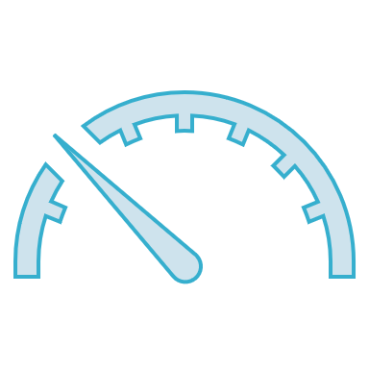


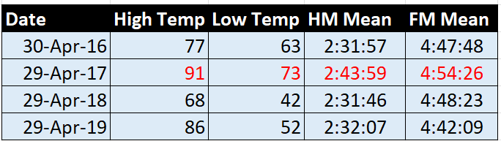
Temperature Factors
2017 Half Marathon 8:44 slower than Half Marathon Avg
2017 Full Marathon 5:59 slower than Full Marathon Avg
Anecdotal evidence of runners being unable to finish race due to fever and dehydration.
Suggestive of harsh weather conditions affecting performance.
Note: Temperature correlates to mean performance more strongly with Half Marathon than Full.
Source: https://www.usclimatedata.com/climate/nashville/tennessee/united-states/
Notes:
Data pulled via https://www.usclimatedata.com/climate/nashville/tennessee/united-states/

Slide 6
Thank You
We appreciate your time and are eager to hear what the other groups found.

